Slide 1


Full-Stack Web GIS Based Community Event Portal
Buse Sıla Dolu

Slide 2


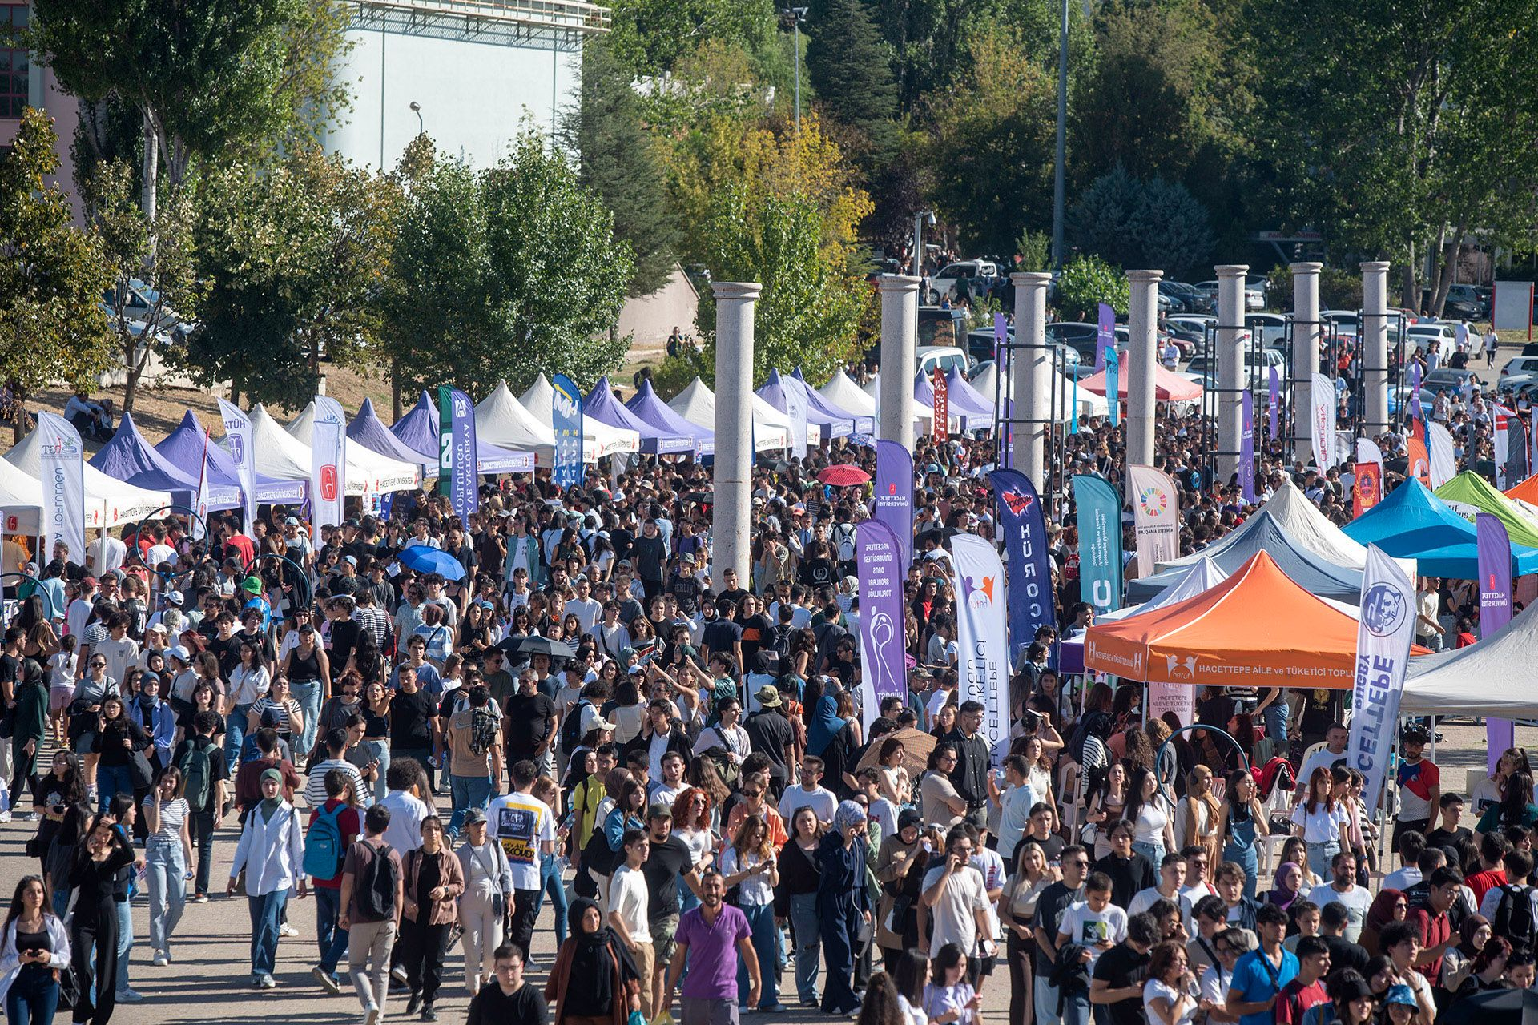


Problem Statement & Motivation
The Problem: University communities often struggle with fragmented information regarding event locations and schedules.
Why This Project? Static lists or social media posts lack spatial context, making it hard for students to visualize where and when events happen.
The Motivation: I chose this project to bridge the gap between GIS (Geographic Information Systems) and daily campus life by providing an interactive map-based solution.

Slide 3
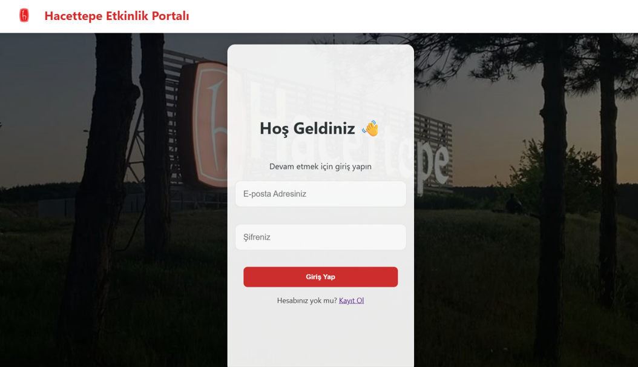
Proposed Solution
Centralized Spatial Hub: A single platform where all community events are visualized on a Hacettepe University map.
Real-time Interaction: Users can register, log in, and dynamically add or remove event markers.
Cloud Accessibility: By hosting the system on the cloud, it becomes accessible to all students 24/7.

Slide 4
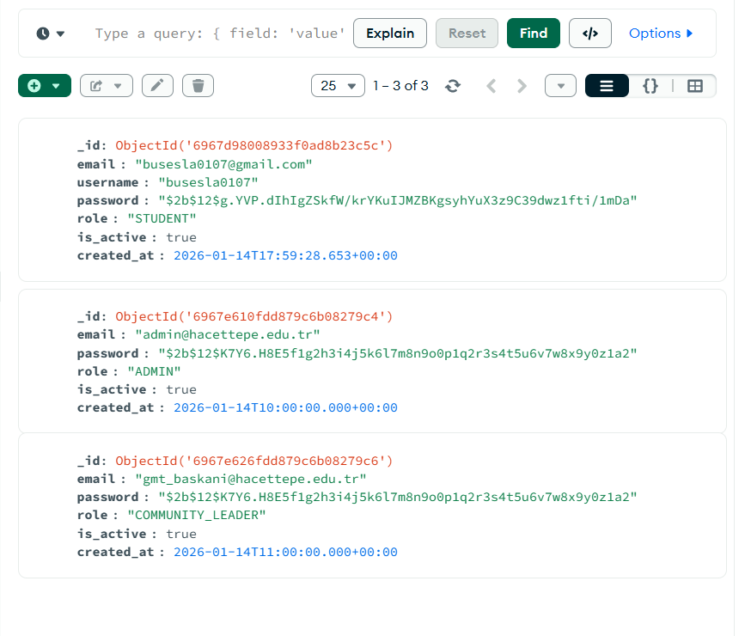
Technical Stack
Frontend: Developed using HTML5, CSS3, and JavaScript, with Leaflet.js for interactive mapping.
Backend: Built with FastAPI (Python) for high-speed, asynchronous API performance.
Database: MongoDB Atlas (NoSQL) was utilized for flexible GeoJSON data storage.
Security: Password encryption via bcrypt and secure authentication flows.

Slide 5
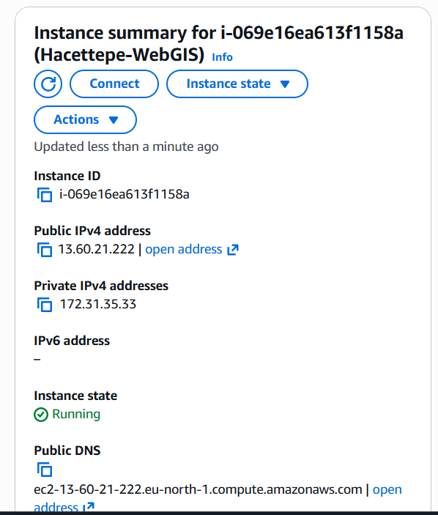
System Architecture
Cloud Infrastructure: The backend is hosted on an AWS EC2 Instance (Ubuntu 22.04 LTS).
Data Flow: The Frontend sends HTTP requests to the AWS-hosted API, which then interacts with the MongoDB Atlas cloud database.
Persistence: Used nohup and background processes on AWS to ensure the API remains "Live" even after terminal sessions end.

Slide 6
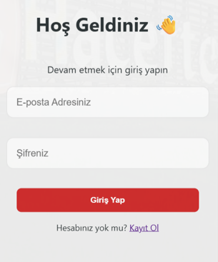

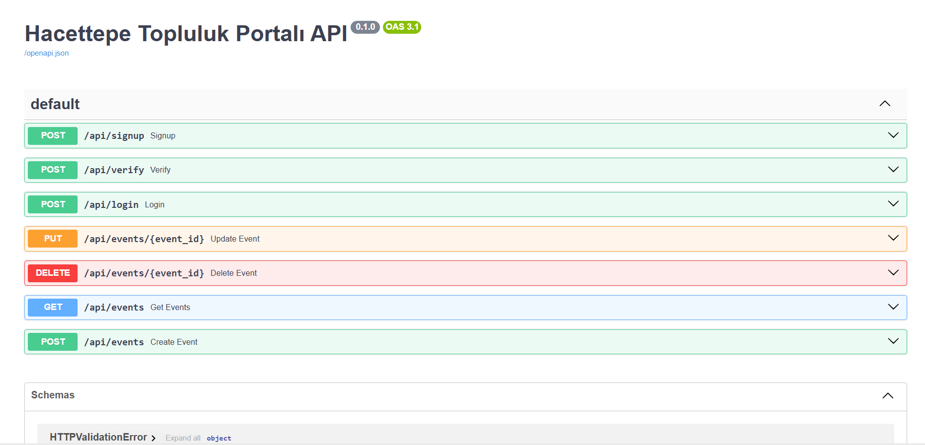
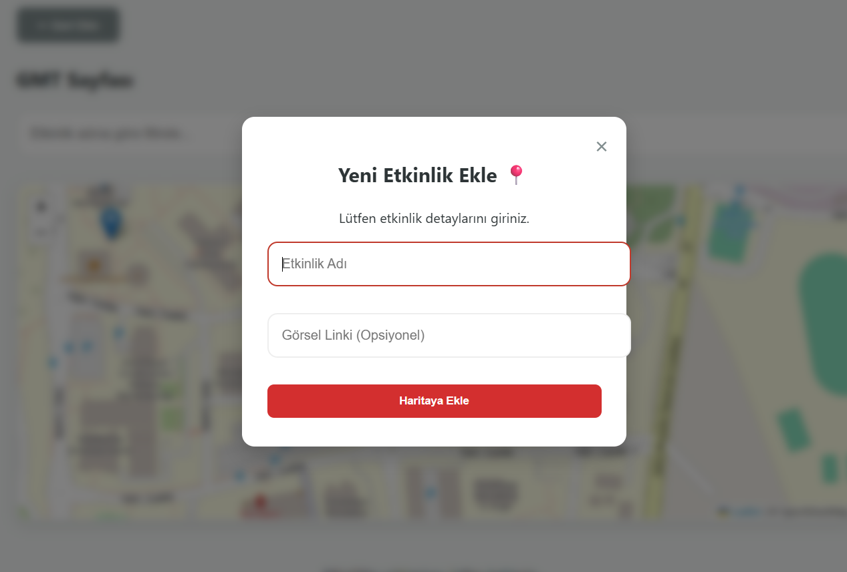
Application Features
Live API Docs: Fully documented endpoints available via Swagger UI
Map Operations: Users can click on the map to create new event markers with specific details.
Live Dashboard: An interactive sidebar that lists all current events, allowing for easy management and deletion.

Slide 7
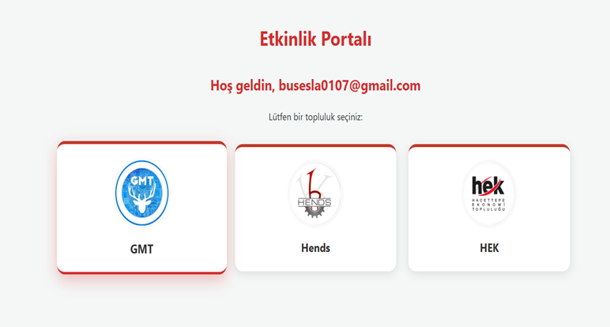
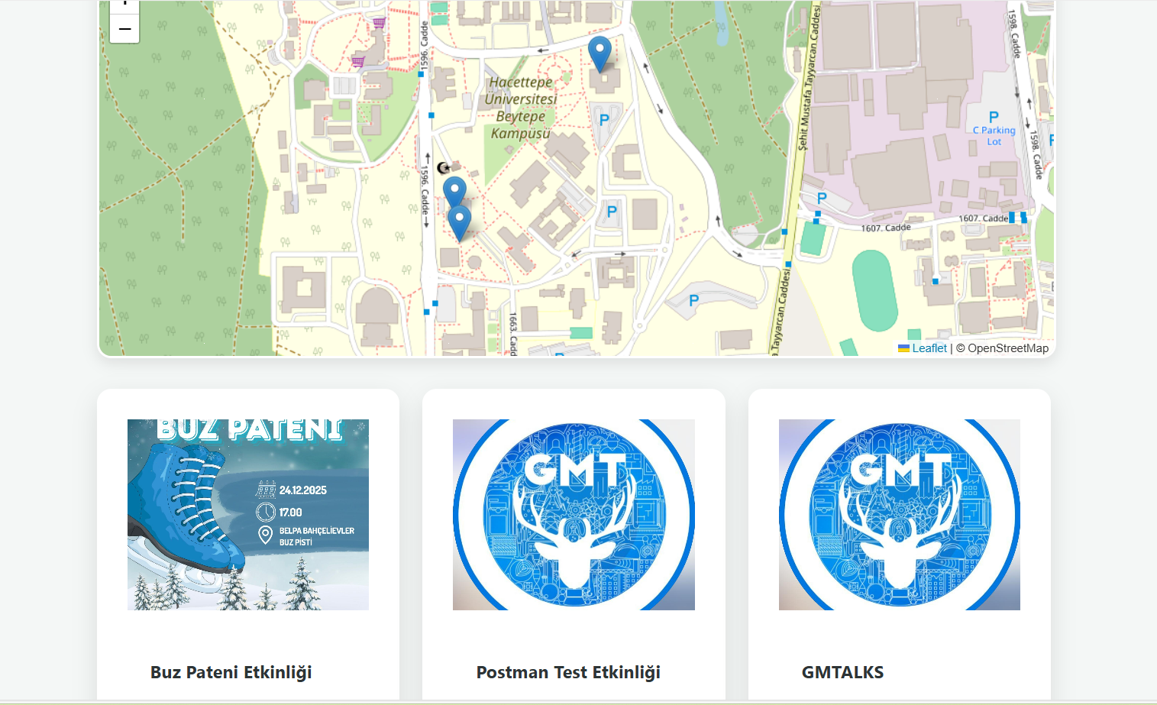

Slide 8

THANK YOU FOR YOUR ATTENTION !

